Slide 1
12-lead ECG Classification Using
Deep Neural Networks
GROUP MEMBERS
Khuzaima Shahid MSDS20039
Aiman Younas MSDS20087
Qazi Danish Ayub MSDS20075
Muhammad Uzair MSDS20053
Hira Saleem MSDS20102

Slide 2
Introduction
The electrocardiogram (ECG) is a non-invasive representation of the electrical activity of the heart from electrodes placed on the surface of the torso.The standard 12-lead ECG has been widely used to diagnose a variety of cardiac abnormalities such as cardiac arrhythmias, and predicts cardiovascular morbidity and mortality.

Slide 3
Motivation
The early and correct diagnosis of cardiac abnormalities can increase the chances of successful treatments.
The manual interpretation of the electrocardiogram is time-consuming
It requires skilled personnel with a high degree of training.
Automatic detection and classification of cardiac abnormalities can assist physicians in the diagnosis

Slide 4
Problem Statement
To develop a method using deep neural network for classifying cardiac abnormalities from 12-lead ECGs

Slide 5
Related Work
Papers | Methodology
[1] | A modified residual convolutional network
[2] | Residual-CNN GRU neural network with an attention mechanism
[3] | Deep learning model SEResNet34(34-layer ResNeT)
[4] | Deep residual neural networks

Slide 6
Datasets
The data for this Challenge are from multiple sources:
CPSC Database and CPSC-Extra Database
INCART Database
PTB and PTB-XL Database
The Georgia 12-lead ECG Challenge (G12EC) Database
Undisclosed Database

Slide 7
Data profile for the Training set
Dataset | Sample freq. (Hz) | Duration (s) | Num. of records
PTB-XL | 500 | 10 | 21837
CPSC-Extra | 500 | 10 - 98 | 3453
CPSC | 500 | 9 - 118 | 6877
PTB | 1000 | 38.4 - 120 | 516
Georgia | 500 | 10 | 10344
St Petersburg | 257 | 1800 | 74

Slide 8
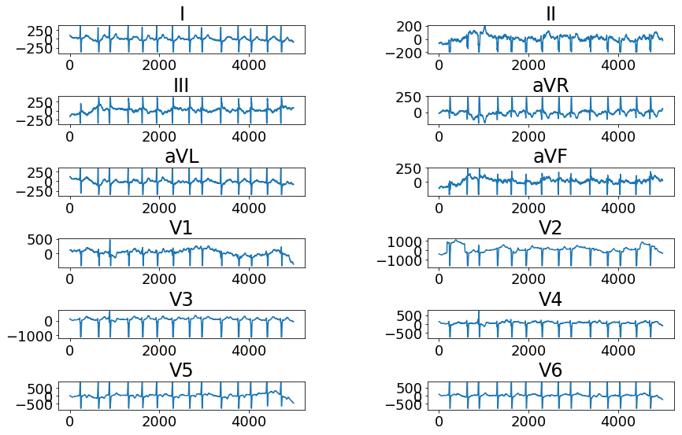
Typical example of raw 12-lead ECG with atrial fibrillation

Slide 9
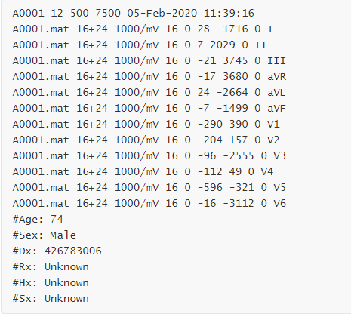
Data Header

Slide 10
Methodology
We have proposed two models to classify ECG rhythm diagnoses over a broad range of frequent and essential diagnoses. Our first model is based on 1-dimensional convolutional and max pooling layers stacked together for feature extraction, Our second model, which uses a Resnet based CNN .And then for classification purpose we have used binary SVMs.

Slide 11
Pre-Processing steps
1.All signals resampled to 500hz
2.Frame length = 17920
3.Inversion removed if spotted
4.Each Frame Normalized
5.Bandpass filtered (To remove extremely high or low amplitude)
6.Signal Padded or truncated accordingly

Slide 12
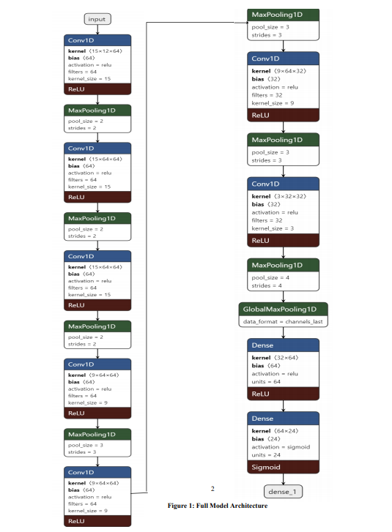
Architecture of Model 1

Slide 13
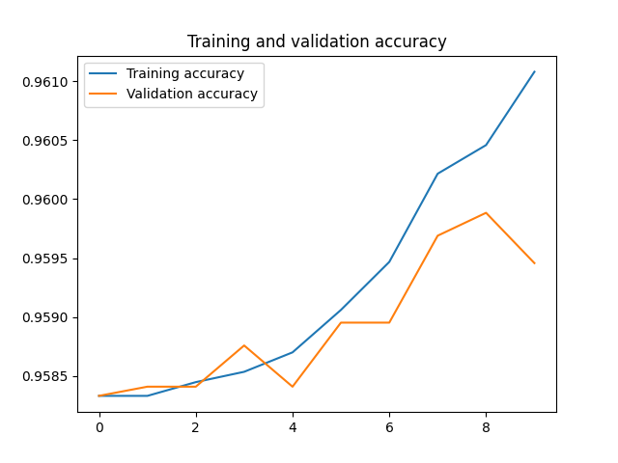
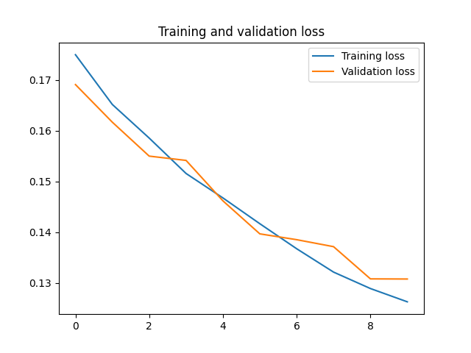

Slide 14
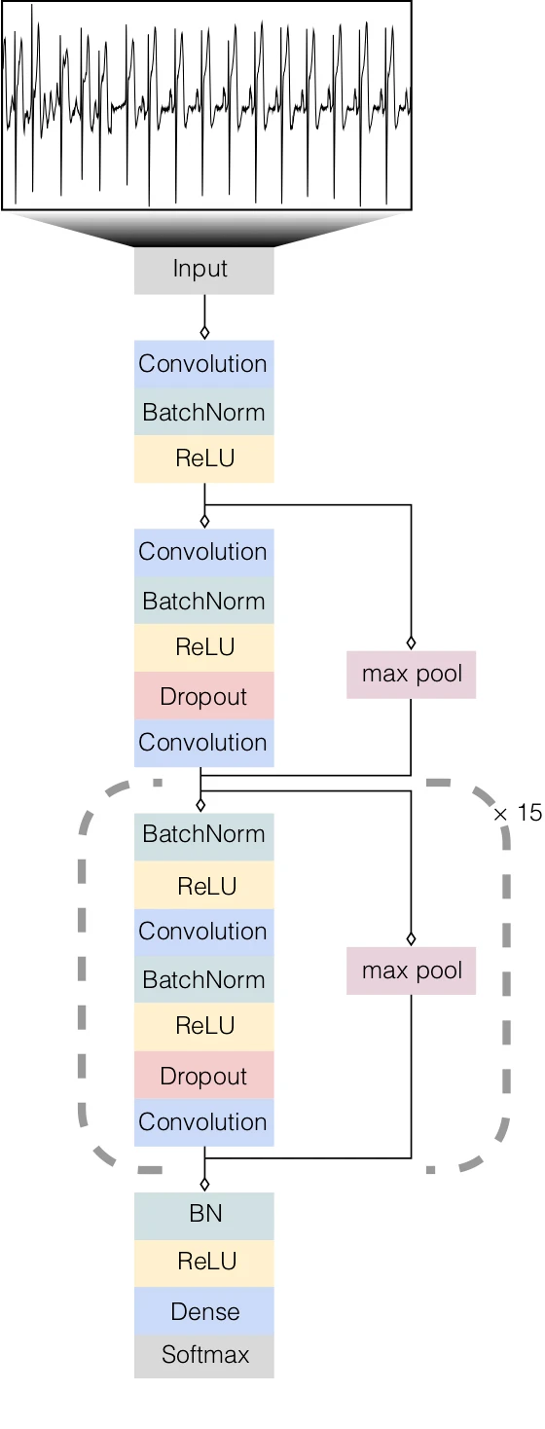
Architecture of Model 2

Slide 15
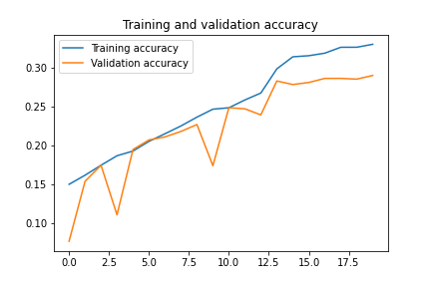
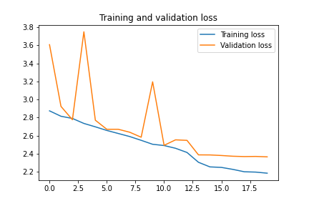

Slide 16
Binary SVCs for Classification Purpose
For each of the scored classes a separate SVC was created
Each SVC was trained in the form of 1 vs rest classifier
For now a linear kernel was used without tweaking any of the hyperparameters

Slide 17
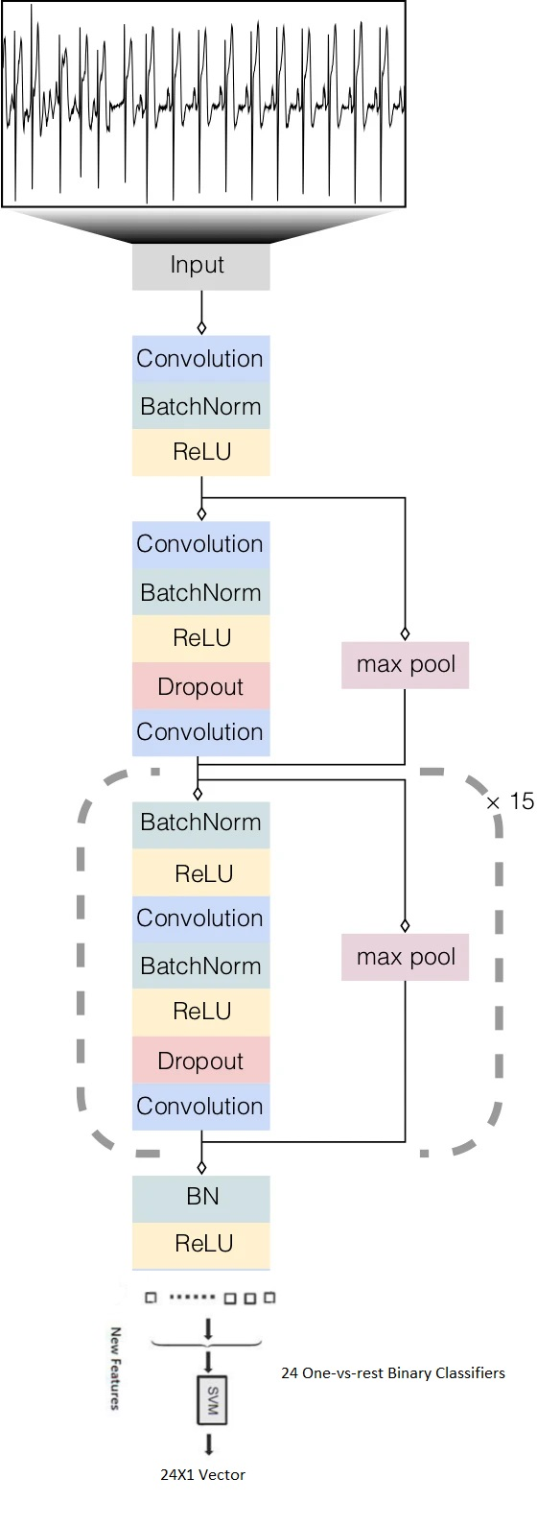
Prediction Flow

Slide 18
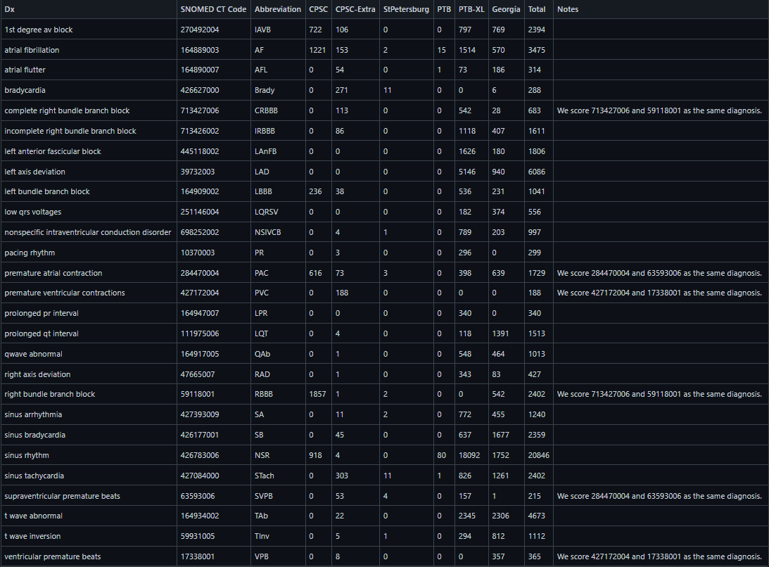
Evaluation (Scored Classes)

Slide 19
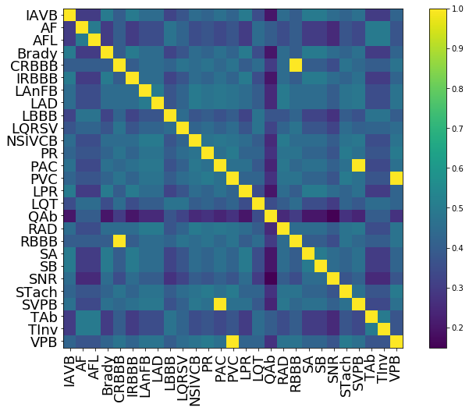
The Reward matrix W
The diagnoses scored in the Challenge
Where columns are the true labe
Columns and Rows are the predicted label

Slide 20
Comparisons of our proposed models
Models | Challenge Metric
[1] | 0.685
[2] | 0.659
[3] | 0.653
[4] | 0.546
Proposed Model 1 | 0.500445
Proposed Model 2 | 0.566569

Slide 21
Comparing Characteristics of both models
Proposed Model | AUROC | AUPRC | Accuracy | F measure | F_beta_measure (beta=2) | Challenge Metric
Model 1 | 0.82077 | 0.342646 | 0.009588 | 0.342446 | 0.465158 | 0.500445
Model 2 | 0.88942 | 0.428499 | 0.05172 | 0.398659 | 0.544561 | 0.566569

Slide 22
Future Work
Train on entire dataset
Hyperparameter Tuning of Support Vector Machines

Slide 23
Contribution
Khuzaima Shahid , Aiman Younas and Qazi Danish:
Managing the implementation of the model by looking at the prior work for attaining better accuracies.
Muhammad Uzair and Hira Saleem:
Responsible for the understanding and pre-processing of data in the implementation part.

Slide 24
References
[1] Multi-label Classification of Electrocardiogram With Modified Residual Networks Shan Yang1 , Heng Xiang 1 , Qingda Kong1 , Chun Li Wang 1.1 Chengdu Spaceon Electronics Co, Ltd, Chengdu, China.
[2] Utilization of Residual CNN-GRU With Attention Mechanism for Classification of 12-lead ECG Petr Nejedly, Adam Ivora, Ivo Viscor, Josef Halamek, Pavel Jurak, Filip Plesinger Institute of Scientific Instruments of the Czech Academy of Sciences, Brno, Czech Republic.
[3] Automatic Detection and Classification of 12-lead ECGs Using a Deep Neural Network Wenxiao Jia 1 , Xian Xu 1 , Xiao Xu 1 , Yuyao Sun1 , Xiaoshuang Liu 1 1 Ping An Health Technology, Beijing China.

Slide 25
References
[4] Automatic 12-lead ECG Classification Using Deep Neural Networks Wenjie Cai, Shuai Cong Hu, Jingying Yang, Jianjian Cao University of Shanghai for Science and Technology, Shanghai, China
[5] Chandan Kumar Jha, Maheshkumar H. Kolekar,
Cardiac arrhythmia classification using tunable Q-wavelet transform based features and support vector machine classifier,Biomedical Signal Processing and Control,Volume 59,2020,101875,ISSN 1746-8094
[6] R. Thilagavathy, R. Srivatsan, S. Sreekarun, D. Sudeshna, P. L. Priya and B. Venkataramani, "Real-Time ECG Signal Feature Extraction and Classification using Support Vector Machine," 2020 International Conference on Contemporary Computing and Applications (IC3A), 2020, pp. 44-48, doi: 10.1109/IC3A48958.2020.233266.

